Slide 1
Online Grievance Redressal System
Submitted by
Tasnova Tasnim
Rubyat jesmin Shammi
30th August 2022

Slide 2
Proposed By:
Tasnova Tasnim
UG02-47-18-012
Rubyat jesmin Shammi
UG02-47-18-034
Project Proposal
CSE-0400 | Project work
Dept. Of CSE
State University Of Bangladesh
Supervised By:
Muhammad Masud Tarek
Associate Professor (Acting Head)
Dept. of CSE
State University Of Bangladesh

Slide 3
Overview
Introduction
Scope and Limitation
Overall Description
System Analysis & Design
Database Table
Requirement Specifications
Sample Interfaces
Literature Review
Future Enhancements
Conclusion
References

Slide 4
Introduction
Grievance is a depressing state of affairs caused by any evil or hardship you are suffering from a person, which makes valid reasons for complaining as well the complaint requires remedial action. The grievance redressal system is part of standard equipment of any handling Complaint resolution is considered a parameter for measuring the effectiveness of an organization. The standard grievance redressal system (GRS) is shown it works activities for a number of purposes including securing a democratic institution , to inform all teachers and students of their rights and thus to ensure quality and capacity building of the organization. In addition, Considering the nature of the complaint and the magnitude of the complaint, a thorough investigation is conducted by members, followed by the imposition of a punisment if anyone is found guilty.

Slide 5
Scope and Limitation
SCOPE
LIMITION
The scope of project is the system on which the software is installed, i.e., the project is developed as a desktop application. But later on, the project can be modified to operate for many institutions. In future, the system can be automated using students’ in mobile application and high security.
This Software is limited to cover only all the manual procedure involved during the complain management system. Requires an active internet connection.

Slide 6
Overall Description
GRC
Proctor
Department
Student Module
Login
Manage own profile
Dashboard
See Student complains lists
Manage department
Manage proctor
Add student and department also
Login
Manage own profile
Dashboard
See Student details
See Student complains
Manage department
Login
Dashboard
See Student details
See Student complains
Add student
Solved problem and if any problem transfer the other admin
View own profile
Create complain
Upload complains file
View and messageing with admin
See complains status

Slide 7
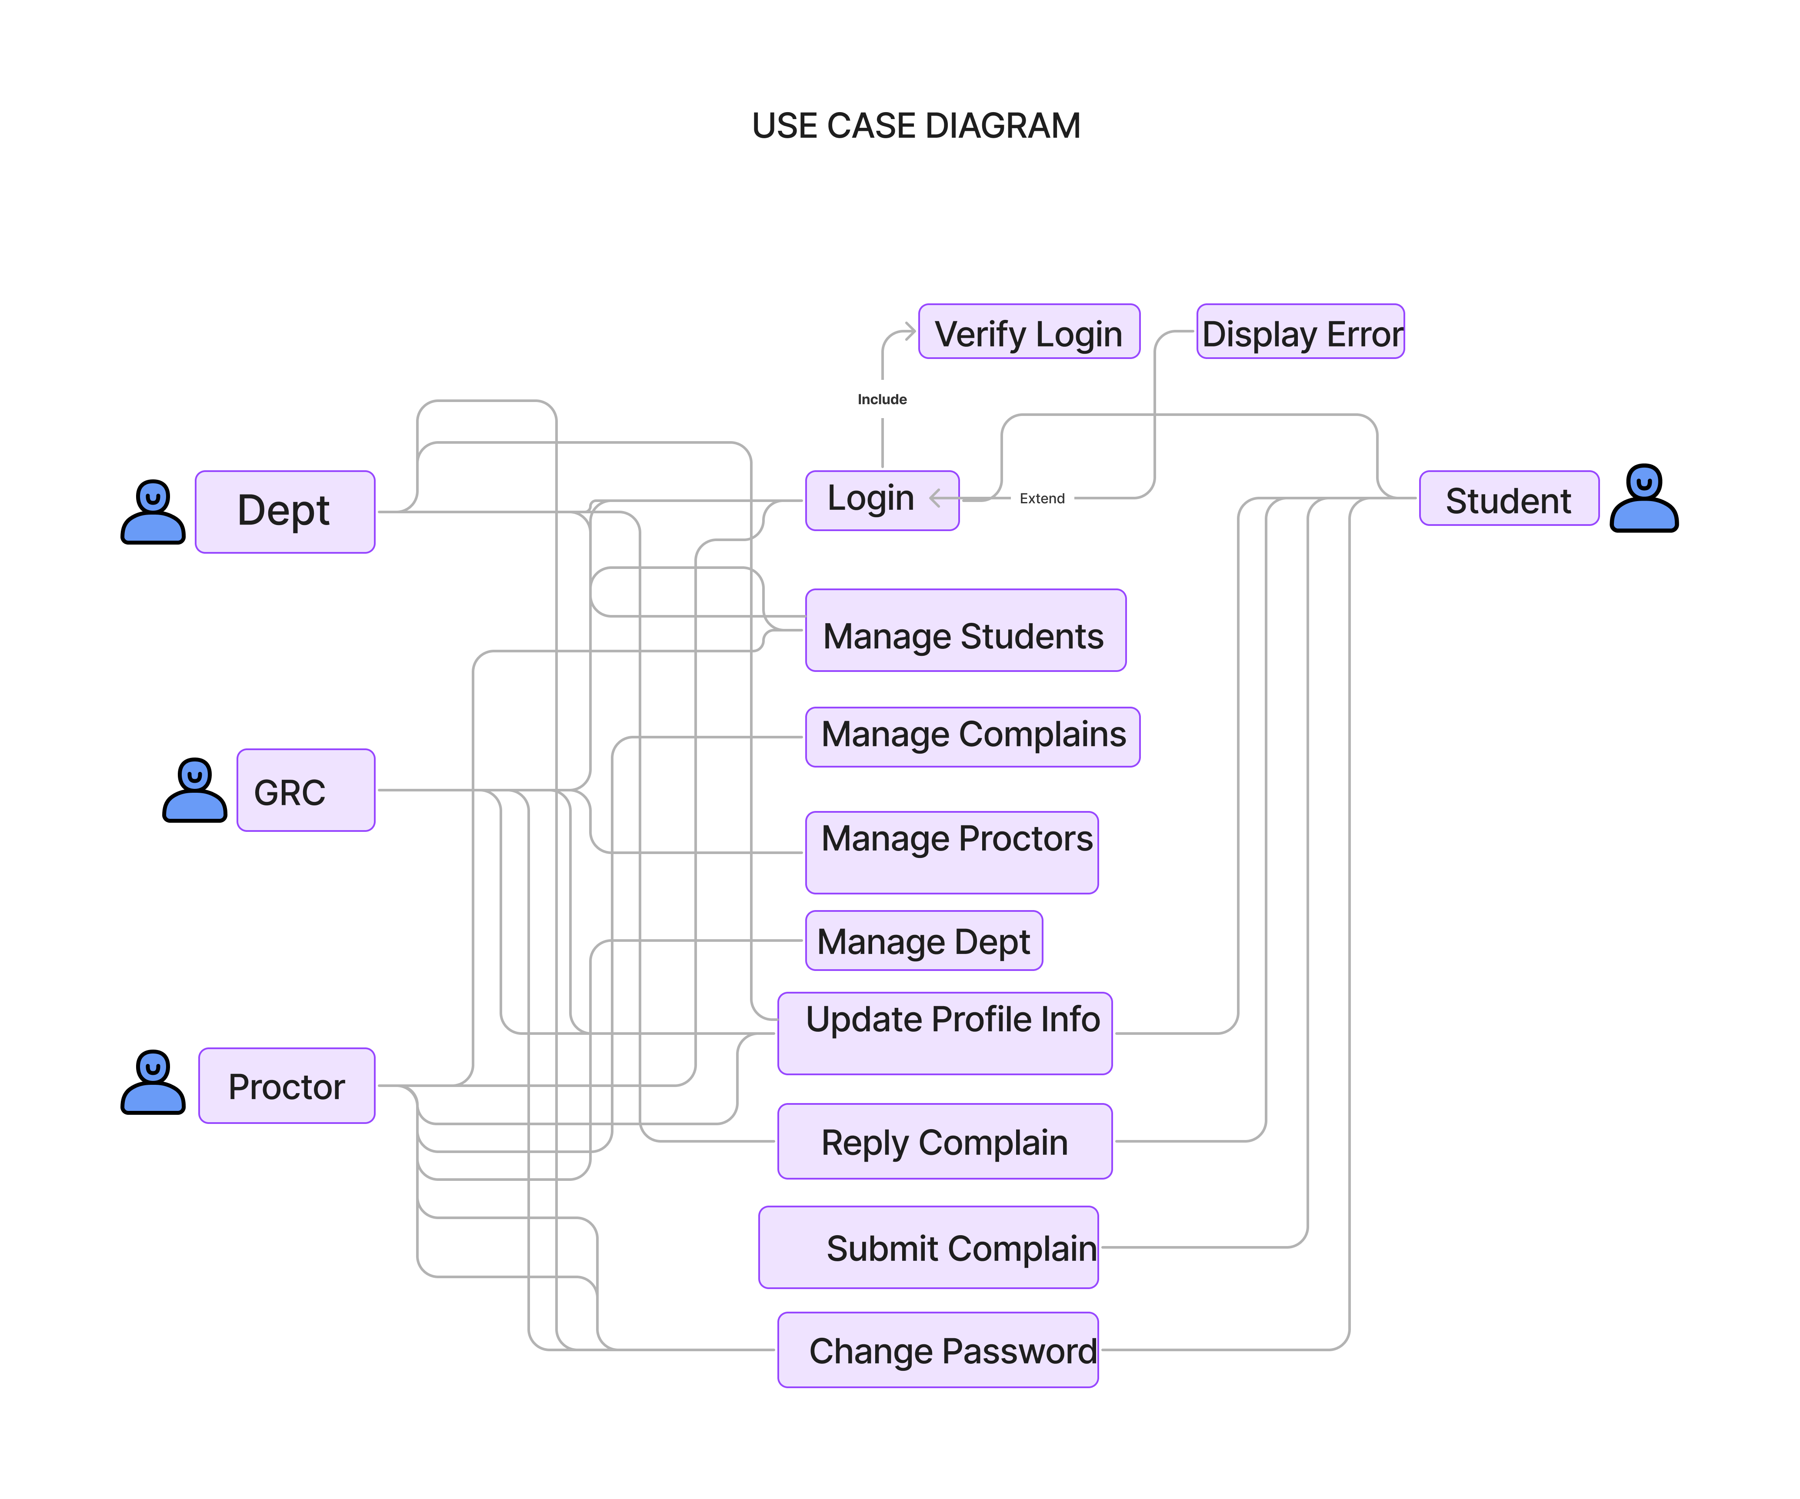
Use case diagram

Slide 8
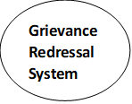
Data Flow Diagram
Level 0 DFD

Slide 9
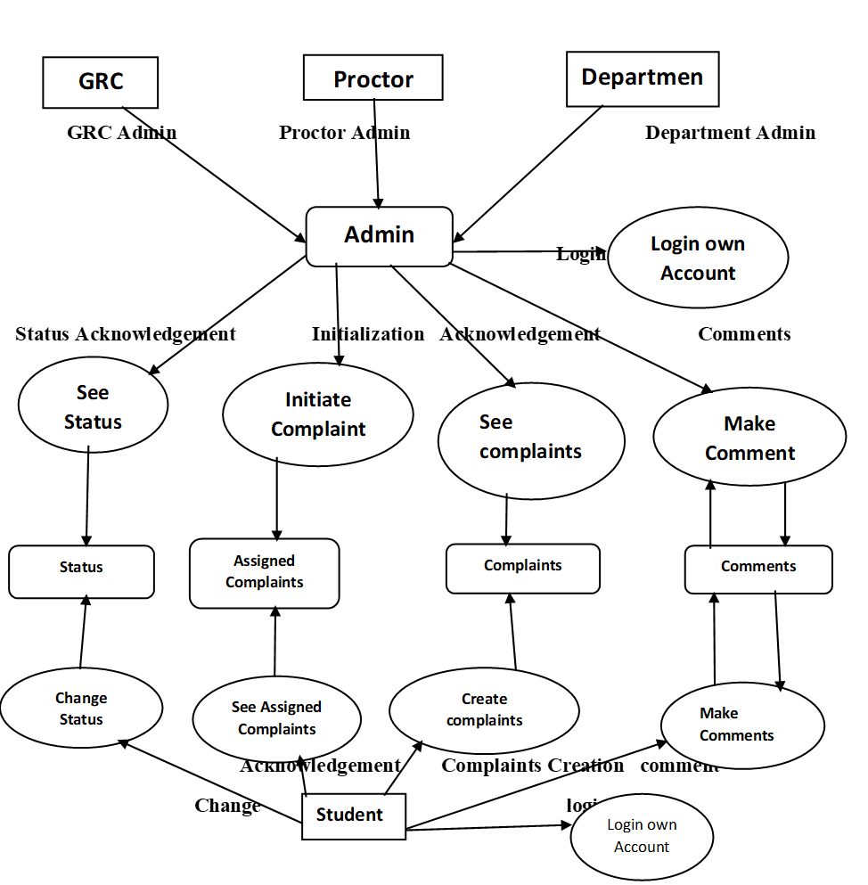
Level 1 DFD

Slide 10
ER Diagram

Slide 11
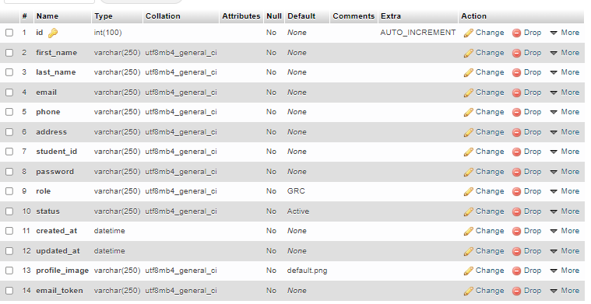
Database Design
GRC ADMIN TABLE

Slide 12
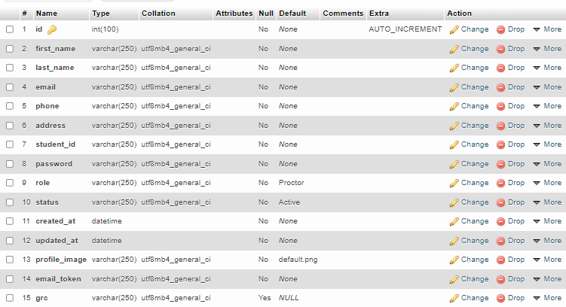
PROCTOR ADMIN TABLE

Slide 13
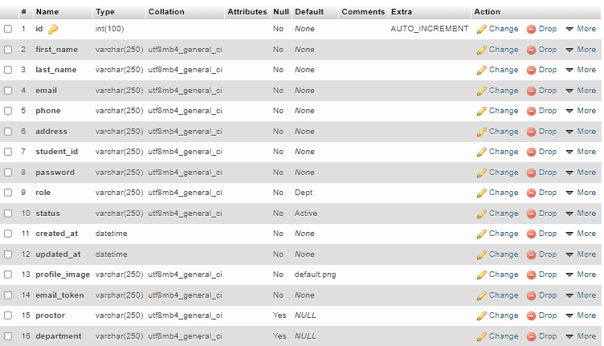
DEPARTMENT ADMIN TABLE

Slide 14
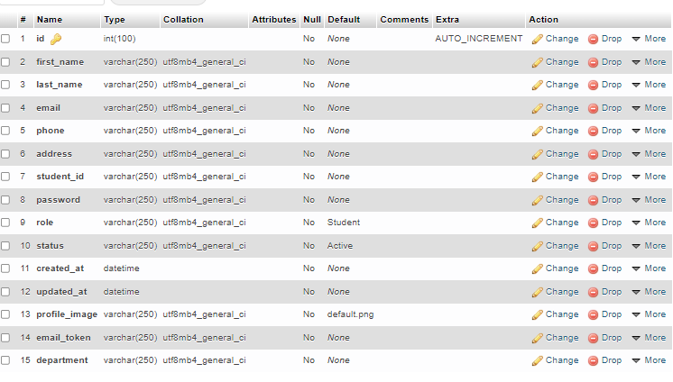
STUDENT TABLE

Slide 15
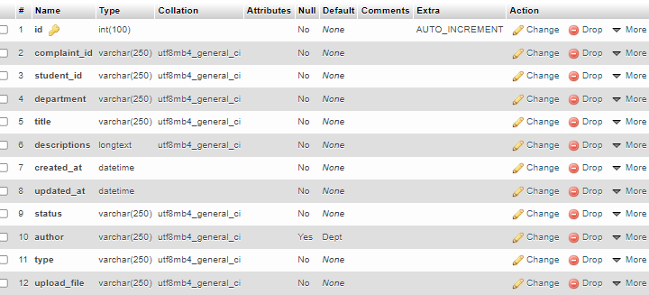
COMPLAIN TABLE

Slide 16
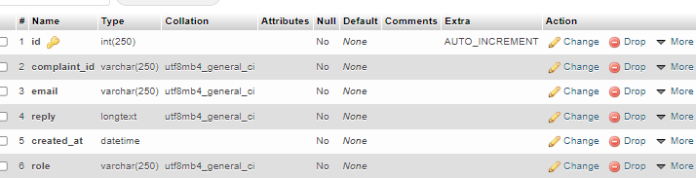
COMPLAINLIST TABLE

Slide 17
Requirement Specifications
Software
Hardware
Back End
PHP
SQL
Front End
HTML
CSS
Bootstrap
Any internet connected device like Tablet PC & Desktop PC etc.
Microsoft windows 7 and above.
Processor: From 1.30GHz up to 3.50 GHz

Slide 18
Gantt Chart

Slide 19
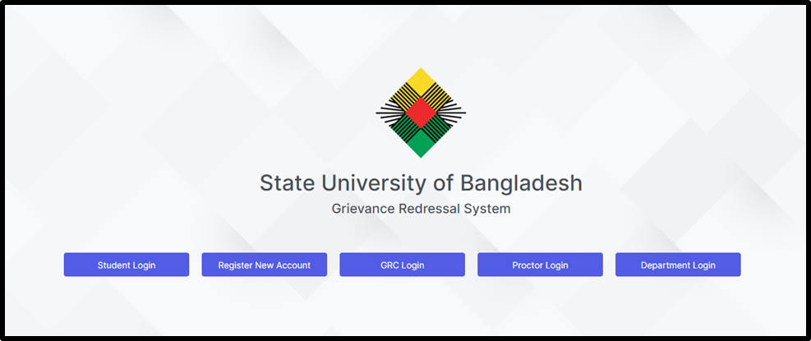
Sample Interfaces
Login Page

Slide 20
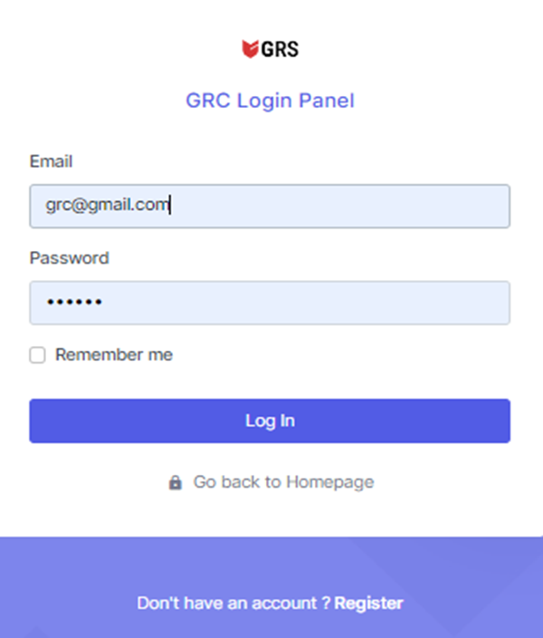
Admin Login

Slide 21
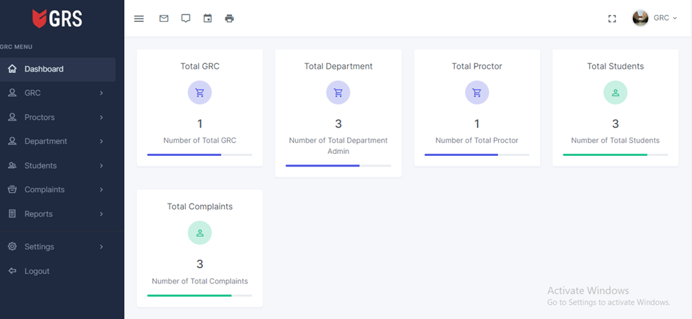
Admin Dashboard

Slide 22
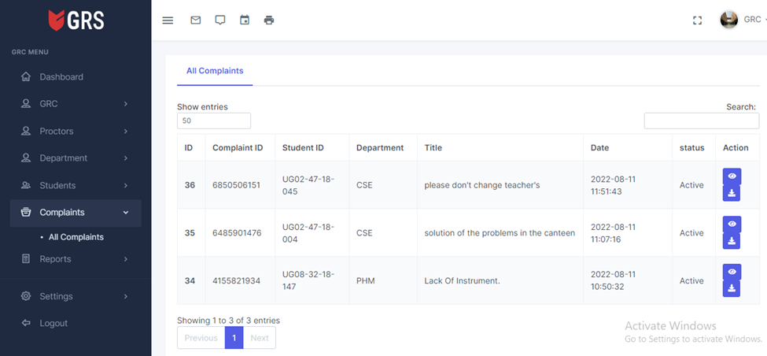
Student complain details

Slide 23
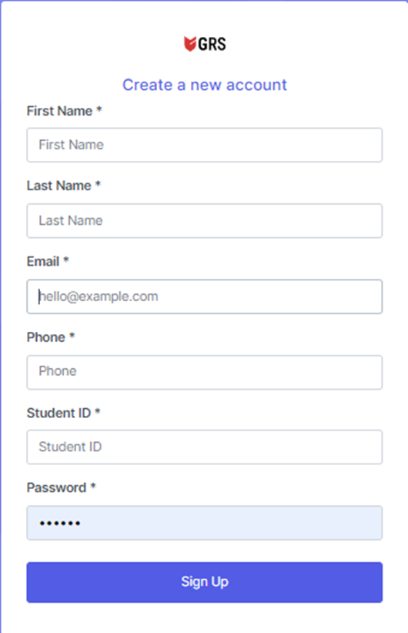
Student Registration

Slide 24
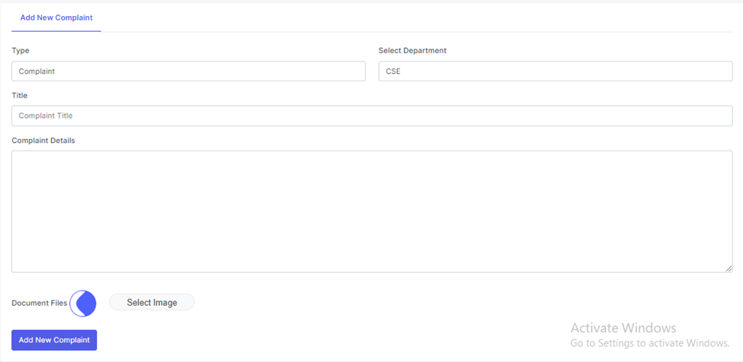
Student create Complain

Slide 25
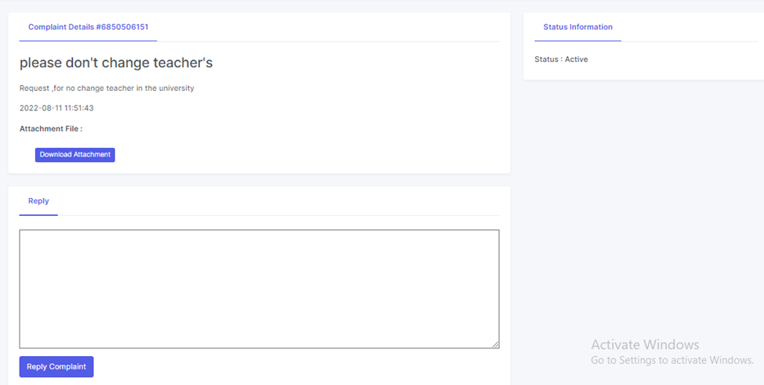
Student Complain Details

Slide 26
Literary Review
[1] In the literature, reporting is available on the need for and use of GRS for various domains such as, public administration, Municipality university harassment cases in the student community, and sexual harassment in the area organization.
[2]In , to analyze the various online services offered, especially the provinces, also introduced the importance of online grievance redressal . Various government GRS related factors have been considered, and estimates have been made.
[3] evaluates the implementation of the registration system in Bangladesh. Afraid of revealing your identity makes the complainant anonymous or false. It is a difficult task for the authorities to know the plaintiff’s authenticity. Therefore, a solution was presented so that the plaintiffs could complain brave, at the same time allowing the authorities to investigate the emergence of complaints.

Slide 27
Future Enhancements
1. The mobile application is intended to enhance user experience by providing the user with additional features for uploading images in the form of audio or video files, which may improve the ability to resolve cases especially in such cases at high cost of firmness.
2. Above all, the tracker can be added as part of future ideas to track the performance of the various committee members involved in the system on the basis of the provided aspect of the report production

Slide 28
CONCLUSION
This project addressed Grievance Redressal System in State University of Bangladesh, Dhaka, Bangladesh. This website is mainly designed to reduce the manual efforts and receive all complaints about university and also for providing the current status of complaints and managing data of complaints and make the work easier for users and the complaint solvers.

Slide 29
REFERENCES
1. Subhash, C., Ashwani K., Assessing grievance redressing mechanism in India. Int. J. Comput. Appl. 52 (5), 12–19 (2012)
2. 2. Dipankar, M., Solution towards an effective grievance redressal system in Indian Scenario. In: IJCA Proceedings on National Conference on Advancement of Technologies — Information Systems & Computer Networks (ISCON - 2012), vol. 1, pp. 1- 2 (2012)
3. Varun, G., Redressing grievance and complaints about basic service delivery. World Dev. 41, 109–119 (2013)
4. Nripendra, P.R., Yogesh, K.D., Michael, D.W., Vishanth, W .: Investigating the success of an e- government initiative: validation of the integrated IS success model. Inf. Syst. Front. 17 (1), 127–142 (2015)
5. Rajesh, K.Y., Sarvesh, M .: The role of insurance mediator and grievance management In life insurance services in an Indian perspective. Int. Lett. Soc. Humanist. Sci. 31,9– 1 (2014)
6. Gianluca, M., Karin, P., Javier, M., Rahul, D .: Openness May Not Mean Democratization- eGrievance Systems in their Consequences. 14th N-AERUS and GISDECO, University of Twente, The Netherlands (2013).
7. Van Jasper, T., Isa, B .: Excercising citizenship invited and negotiated spaces in grievance redressal system Hubli-Dharwar. Environ Urbanization ASIA 2 (2), 169–185 (2011)

Slide 30


